Slide 1
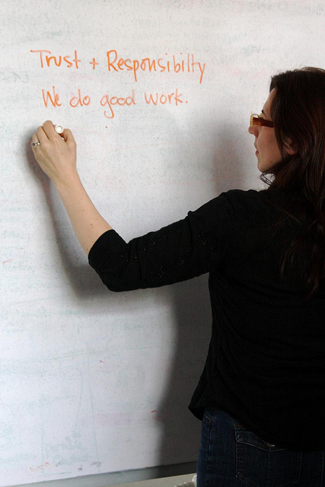
PROJECT WHITEBOAD
Username
Password
Forgot your password, dumbass?

Slide 2
WELCOME, STUDENT NAME!
Search for a class
Class List
Math 101
English 101
Biology 101
CS129
Instructor | Contact
Al Bundy | Ext 996
Peg Bundy | Ext 995
Meg Griffin | Ext 0
Ace Ventura | Ext 007

Slide 3
Math 101 Homepage
Meg Griffin Contact
megisntsobad@gmail
ASSIGNMENTS
First day assignment
First week homework
First week Quiz study guide
Bonus assignment
LINKS FOR LEARNING
www.mathhelp.com
www.addthingseasily.org
www.nochildleftbehind.gov

Slide 4
YOUR GRADES
ASSIGNMENTS | GRADE
Page 14 | 95%
Page 40 | 82%
Page 61 | 87%
Quiz 1 | 90%
Test 1 | 85%
Bonus | 100%
Overall | 90% ish

Slide 5
ALL COURSE GRADES
COURSE | GRADE
Math 101 | 92%
English 101 | 90%
Biology 101 | 82%
CS129 | 100%

